Slide 1
ANALYTICS AVENUE RESEARCH AND DEVELOPMENT
TALENTENA 2024 - WALL OF VISUALS - Q1

Slide 2
INTRODUCING ANALYTICS AVENUE
Analytics Avenue is an educational platform specializing in providing comprehensive guidance and mentorship in the field of data science and analytics.
Tailored for students, unemployed individuals, and those seeking a career transition.
Analytics Avenue focuses on imparting expertise in SQL, Power BI, Python, Data Science, and Machine Learning.

Slide 3
TEAM MEMBERS
Abinaya Palanisamy - View Resume
Vibinraj. D - View Resume
Yokesh. A - View Resume
Vijayalakshmi P - View Resume
Lakshmi
Rohit
Karthi

Slide 4
PROBLEM STATEMENT
CRYPTO MARKET TREND AND SENTIMENTAL ANALYSIS
In the realm of cryptocurrency, understanding market trends and sentiment poses a significant challenge due to the market's inherent volatility and susceptibility to sentiment-driven fluctuations.
Developing robust and accurate sentiment analysis tools capable of effectively interpreting and predicting sentiment trends within this rapidly evolving market remains a pressing need.
DATA - View the data

Slide 5
APPROACH
Collecting data using Web Scraping
Collecting data using Web Scraping
Collection of data using Web Scraping
Data Cleaning
Data Processing
Understanding the data
Analysing the metrics
Visualizing the data

Slide 6
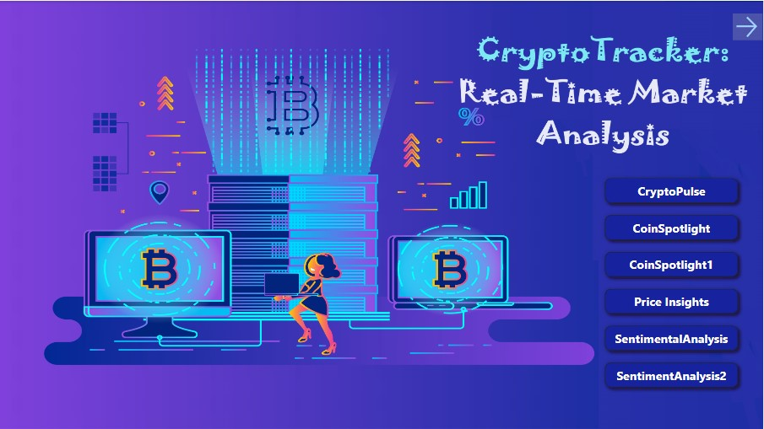

Slide 7
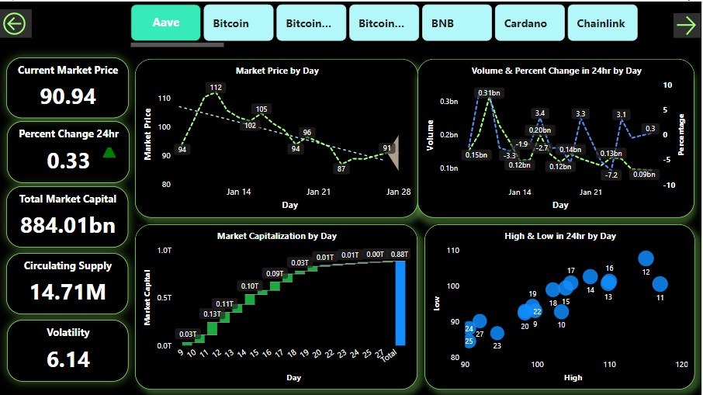

Slide 8
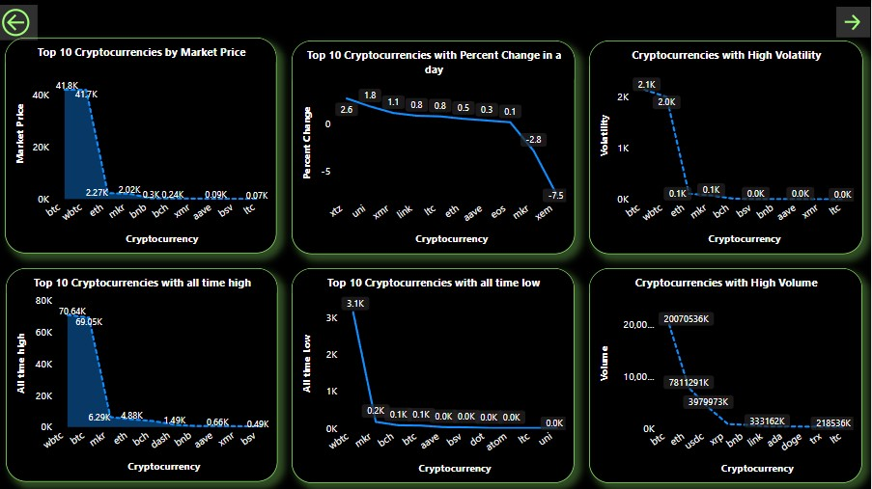

Slide 9
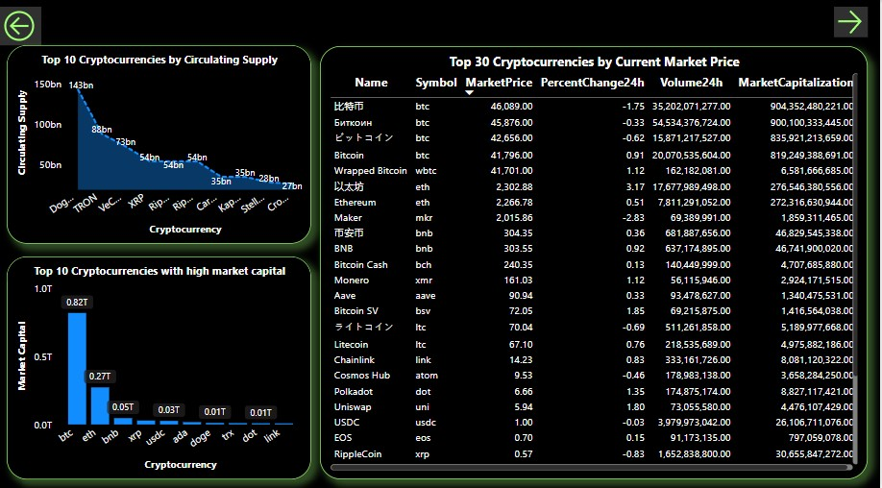

Slide 10
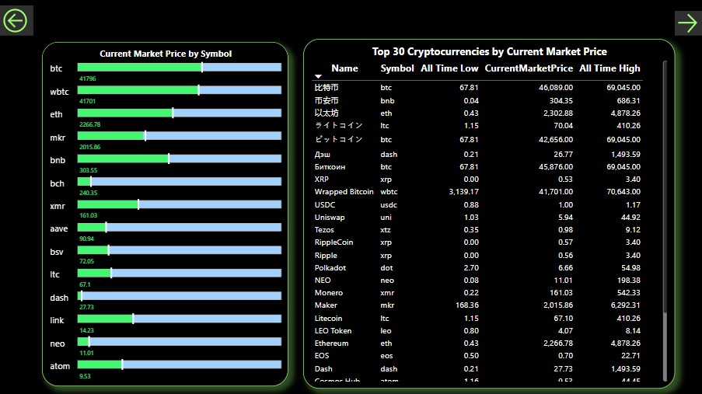

Slide 11
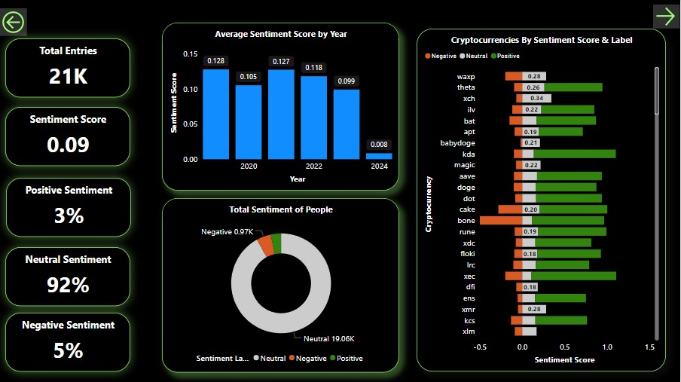

Slide 12
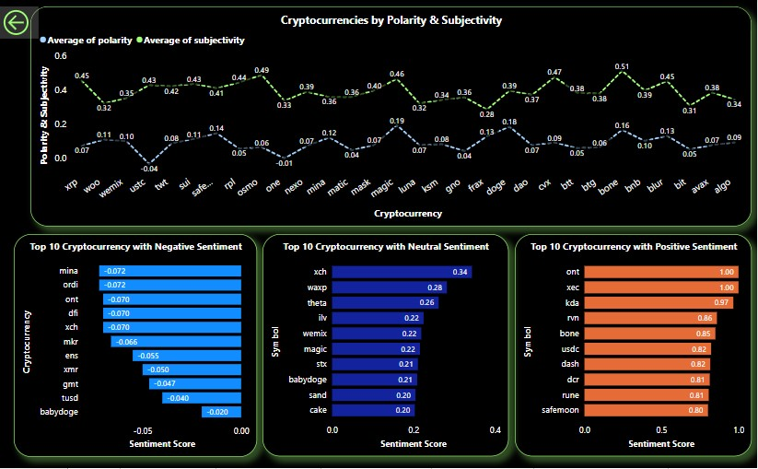

Slide 13
INSIGHTS
Market Price of Bitcoin is the highest of all the other Cryptocurrencies.
TileCoin has the highest change in price percentage in 24 hr.
Bitcoin has the highest volatility.
Wrapped Bitcoin has highest all time high and low of all cryptocurrencies.
Bitcoin has the highest volume of all.
Dogecoin has the highest Circulating supply.
Bitcoin has the highest market capital.
Mina has the most negative sentiment of all the cryptocurrencies in the market.
Chia has the most neutral sentiment in the market.
Ontology has the most positive sentiment in the Crypto - market.

Slide 14
INSIGHTS
Considering the information provided:
Bitcoin: It has the highest market capitalization and volume, making it a relatively more stable choice. Bitcoin is often considered a store of value and has a long history in the market.
Wrapped Bitcoin (WBTC): It has the highest all-time high and low, indicating potential for significant price movement. However, this also implies higher volatility and risk.
Ontology: It has the most positive sentiment, which could suggest positive community and market perception. Positive sentiment may correlate with potential for adoption and growth.

Slide 15
USE CASES
Investing and Trading: To make informed decisions about buying, selling, or holding digital assets.
Financial Institutions: To understand market dynamics, evaluate potential investment opportunities, and manage risks associated with digital assets.
Blockchain Companies: To assess the performance of their own tokens or cryptocurrencies, understand market trends, and make strategic decisions.
Regulatory Compliance: To monitor transactions, detect fraudulent activities, and ensure compliance with existing financial regulations.
Research and Education: To study blockchain technology, economics, and the impact of digital currencies on financial systems.

Slide 16
THANK YOU

